Slide 1
IMMOBILIZATION (FIXATION)
University of Basrah
Veterinary Medicine collage
Department of Vet. Surgery and obstetric
Dr. Alaa A. Ibrahim

Slide 2
Objectives of the fixation
Stabilization of bone fragments during healing process
Prevent displacement, angulation, and rotation.
Fixation method used should
Accomplish uninterrupted stabilization at the time of the original surgery
Permit early ambulation
Permit the use of as many joints as possible during the healing period

Slide 3
Methods of Fixation
Limb splintage (coaptation splints, casts, modified Thomas splint)
Bone splintage (intramedullary pin, external skeletal fixator, bone plate)
Compression (lag screw, cerclage/interfragmentary wire, tension band wire, tension band/compression plate)

Slide 4
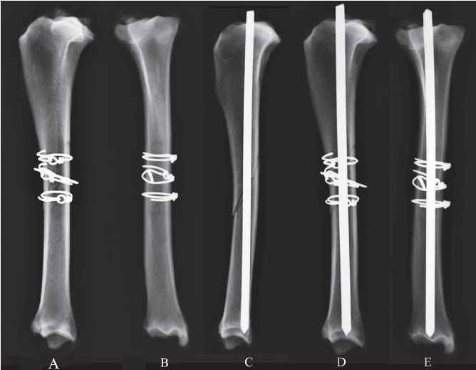
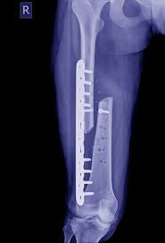
The compression may be static in nature, as with a lag screw or cerclage wire, in which case the compression is not expected to change with time.
Dynamic compression, on the other hand, does change cyclically with loading of the limb as limb function periodically loads and bone surfaces.

Slide 5
Temporary Splintage
Used to reduce additional trauma when delay in reduction and fixation for some reason is suspected
Temporary splintage(e.g., Robert-Jones dressing, c oaptation splint, Thomas splint) of the limb
Fractures distal to the elbow and stifle
The objective in most fracture cases is early reduction and fixation

Slide 6
Coaptation Splints and Casts
“coapt” meaning to approximate
External casts, splints, and bandages are often called “coaptation fixation devices
Rigid materials such as fiberglass, plaster, and splint rod provide the mechanical strength and stiffness required in external coaptation, but these may also endanger the splinted limb if used improperly
Approximate can be accomplished by
Simply immobilizing muscles, as with a bandage
by transmitting compression forces to the bony structures by means of the interposed soft tissues, as with casts and splints

Slide 7
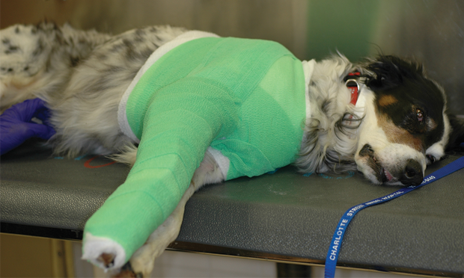
Casts & splint
Molded tubular structures

